Slide 1
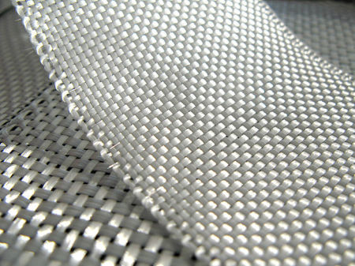
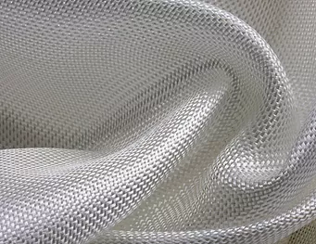
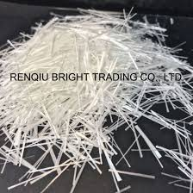
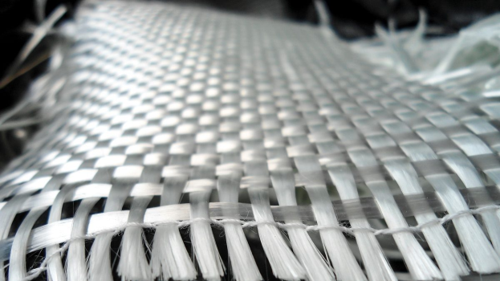
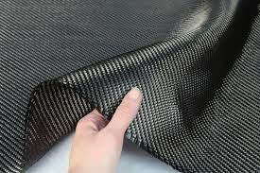
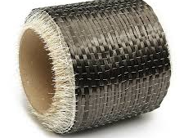
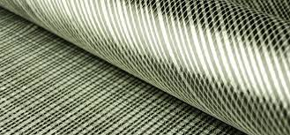
Composite materials Wessam Al Azzawi
Lecture 2: Fiber reinforcement

Slide 2
Theory of machines Wessam Al Azzawi
Lecture 2: Types of fibres
Fibers are the principal constituents in a fiber-reinforced composite material. They occupy the largest volume fraction in a composite laminate and share the
major portion of the load acting on a composite structure. Proper selection of the fiber type, fiber volume fraction, fiber length, and fiber orientation is very important, since it influences the following characteristics of a composite laminate:
1. Density
2. Tensile strength and modulus
3. Compressive strength and modulus
4. Fatigue strength as well as fatigue failure mechanisms
5. Electrical and thermal conductivities
6. Cost

Slide 3
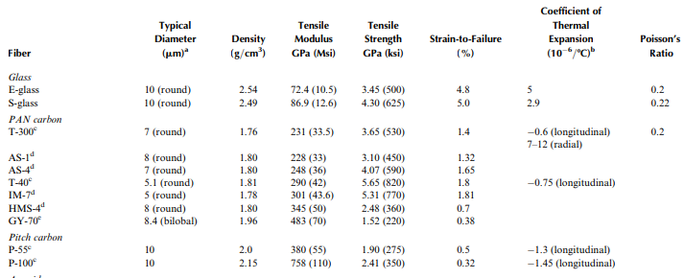
Theory of machines Wessam Al Azzawi
Lecture 2: Types of fibres
A number of commercially available fibers and their properties are listed in the table:

Slide 4
Theory of machines Wessam Al Azzawi
Lecture 2: Types of fibres
Glass fiber
Glass fibers are the most common of all reinforcing fibers for polymeric matrix
composites (PMC). The principal advantages of glass fibers are:
low cost
High tensile strength
High chemical resistance
Excellent insulating properties
The disadvantages are:
Relatively low tensile modulus
High density (among the commercial fibers)
Sensitivity to abrasion
Relatively low fatigue resistance
High hardness (which causes excessive wear on molding dies and cutting tools).

Slide 5
Theory of machines Wessam Al Azzawi
Lecture 2: Types of fibres
Glass fiber
The two types of glass fibers commonly used in the fiber-reinforced plastics (FRP) industry are E-glass and S-glass.
Another type, known as C-glass, is used in chemical applications requiring greater corrosion resistance to acids.
E-glass has the lowest cost of all commercially available reinforcing fibers, which is the reason for its widespread use in the FRP industry.
S-glass, originally developed for aircraft components and missile casings
S-glass, has the highest tensile strength among all fibers in use.
S-glass is higher manufacturing and more expensive than E-glass.
A lower cost version of S-glass, called S-2-glass, has tensile strength and modulus similar to those of S-glass.

Slide 6
Theory of machines Wessam Al Azzawi
Lecture 2: Types of fibres
Glass fiber
The chemical compositions of E- and S-glass fibers are shown in Table 2:
As in common window, the principal ingredient in all glass fibers is silica (SiO₂). Other oxides, such as B₂O₃ and Al₂O₃, are added to modify the network structure of SiO₂ as well as to improve its workability. Unlike glass, the Na₂O and K₂O content in E- and S-glass fibers is quite low, which gives them a better corrosion resistance to water as well as higher surface resistivity. The internal structure of glass fibers is a three-dimensional, long network of silicon, oxygen, and other atoms arranged in a random fashion. Thus, glass fibers are amorphous (noncrystalline) and isotropic (equal properties in all directions).

Slide 7
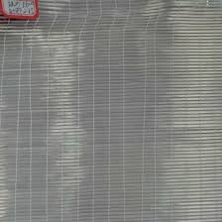
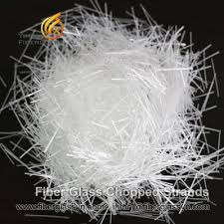
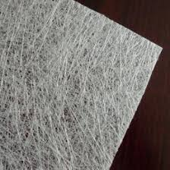
Theory of machines Wessam Al Azzawi
Lecture 2: Types of fibres
Glass fiber
The basic commercial form of continuous glass fibers is:
Strand, which is a collection of parallel filaments numbering 204 or more
Roving is a group of untwisted parallel strands wound on a cylindrical forming package. They are used in continuous molding operations, such as filament winding and pultrusion. They can also be preimpregnated with a thin layer of polymeric
Chopped strands are produced by cutting continuous strands into short lengths
Chopped strands ranging from 3.2 to 12.7 mm are used in injection-molding operations. Longer strands, up to 50.8 mm are mixed with a binder and spread in a random fashion to form chopped strand mats (CSMs)

Slide 8
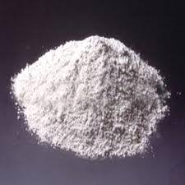
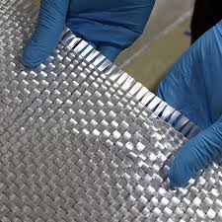
Theory of machines Wessam Al Azzawi
Lecture 2: Types of fibres
Glass fiber
The basic commercial form of continuous glass fibers is:
Milled glass fibers are produced by grinding continuous strands in a hammer mill into lengths ranging from 0.79 to 3.2 mm. They are primarily used as a filler in the plastics industry and do not possess any significant reinforcement value.
Glass fibers are also available in woven form, such as woven roving. Woven roving is a fabric in which continuous rovings are woven in two mutually perpendicular directions. They provide bidirectional properties that depend on the style of weaving as well as relative fiber counts in the length (warp) and crosswise ( fill) directions. A layer of woven roving is sometimes bonded with a layer of CSM to produce a woven roving mat. All of these forms of glass fibers are suitable for hand layup molding and liquid composite molding.

Slide 9
Theory of machines Wessam Al Azzawi
Lecture 2: Types of fibres
Carbon fiber
Carbon fibers are commercially available with a tensile modulus values ranging from 207 GPa to 1035 Gpa . In general, the low-modulus fibers have:
lower density
lower cost
higher tensile and compressive strengths
Higher tensile strains-to-failure than the high-modulus fibers. The advantages of carbon fibers are:
High tensile strength–weight ratios as well as tensile modulus–weight ratios
Very low coefficient of linear thermal expansion (which provides dimensional stability)
High fatigue strengths
High thermal conductivity (which is even

Slide 10
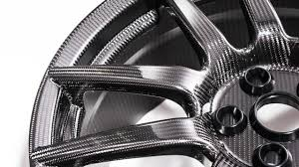
Theory of machines Wessam Al Azzawi
Lecture 2: Types of fibres
Carbon fiber
The disadvantages are:
low strain-to-failure
Low impact resistance
High electrical conductivity, which may cause ‘‘shorting’’ in unprotected electrical machinery.
High cost, which has excluded them from widespread commercial applications.

Slide 11
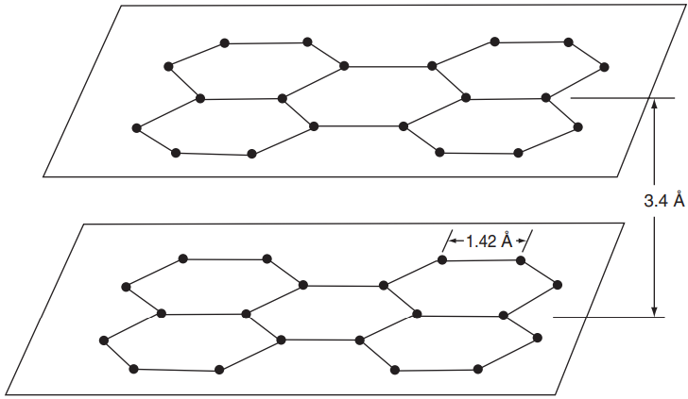
Theory of machines Wessam Al Azzawi
Lecture 2: Types of fibres
Carbon fiber
Structurally, carbon fibers contain amorphous carbon and graphitic carbon. Their high tensile modulus results from the graphitic form, in which carbon atoms are arranged in a crystallographic structure of parallel planes or layers. The carbon atoms in each plane are arranged at the corners of interconnecting regular hexagons. The distance between the planes is larger than that between the adjacent atoms in each plane. Strong covalent bonds exist between the carbon atoms in each plane, but the bond between the planes is due to van der Waals-type forces, which is much weaker. This results in highly anisotropic physical and mechanical properties for the carbon fiber.

Slide 12
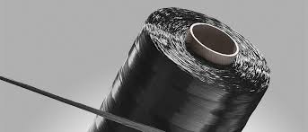
Theory of machines Wessam Al Azzawi
Lecture 2: Types of fibres
Carbon fiber
Carbon fibers are commercially available in three basic forms:
Long and continuous tow
Chopped (6–50 mm long)
Milled (30–3000 mm long).
The long and continuous tow is used for high-performance applications. The price of carbon fiber tow decreases with increasing filament count. Although high filament counts are desirable for improving productivity in continuous molding operations, such as filament winding and pultrusion, it becomes increasingly difficult to wet them with the matrix. ‘‘Dry’’ filaments are not conducive to good mechanical properties.

Slide 13
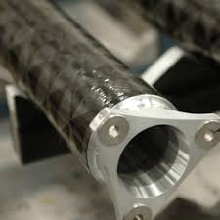
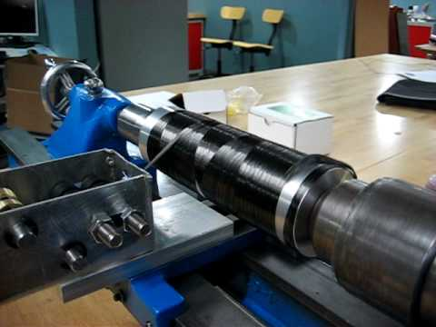
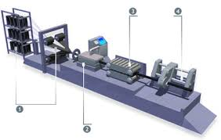
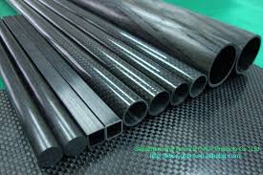
Theory of machines Wessam Al Azzawi
Lecture 2: Types of fibres
Carbon fiber

Slide 14
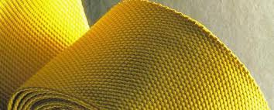
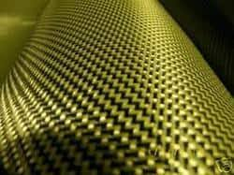
Theory of machines Wessam Al Azzawi
Lecture 2: Types of fibres
Aramid fibers
Aramid fibers are highly crystalline aromatic polyamide fibers that have the lowest density and the highest tensile strength-to-weight ratio among the current reinforcing fibers. Kevlar 49 is the trade name of one of the aramid fibers available in the market. As a reinforcement, aramid fibers are used in many marine and aerospace applications where lightweight, high tensile strength, and resistance to impact damage (e.g., caused by accidentally dropping a hand tool) are important.
Like carbon fibers, they also have a negative coefficient of thermal expansion, which is used in designing low thermal expansion composite panels.
The major disadvantages of aramid fiber-reinforced composites are their low compressive strengths and difficulty in cutting or machining.

Slide 15
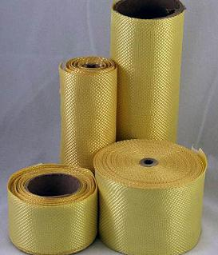
Theory of machines Wessam Al Azzawi
Lecture 2: Types of fibres
Aramid fibers
Kevlar 49 fibers do not melt or support combustion but will start to carbonize at about 4278C.
The maximum long-term use temperature recommended for Kevlar 49 is 1608C.
They have very low thermal conductivity, but a very high vibration damping coefficient.
Except for a few strong acids and alkalis, their chemical resistance is good.
They are quite sensitive to ultraviolet lights.
Prolonged direct exposure to sunlight causes discoloration and significant loss in tensile strength.

Slide 16
Theory of machines Wessam Al Azzawi
Lecture 2: Types of fibres
Aramid fibers
A second-generation Kevlar fiber is Kevlar 149, which has the highest tensile modulus of all commercially available aramid fibers.
The tensile modulus of Kevlar 149 is 40% higher than that of Kevlar 49
The strain-to-failure is lower.
Kevlar 149 has a lower creep rate than Kevlar 49

Slide 17
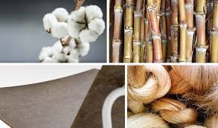
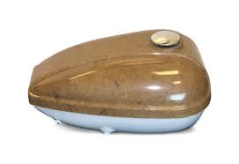
Theory of machines Wessam Al Azzawi
Lecture 2: Types of fibres
Natural fibers
Examples of natural fibers are jute, flax, hemp, remi, sisal, coconut fiber (coir), and banana fiber. All these fibers are grown as agricultural plants in various parts of the world and are commonly used for making ropes, carpet backing, bags, and so on.
The components of natural fibers are cellulose microfibrils dispersed in an amorphous matrix of lignin and hemicellulose. Depending on the type of the natural fiber, the:
Cellulose content is in the range of 60–80 wt%
Lignin content is in the range of 5–20 wt%
The moisture content can be up to 20 wt%.

Slide 18
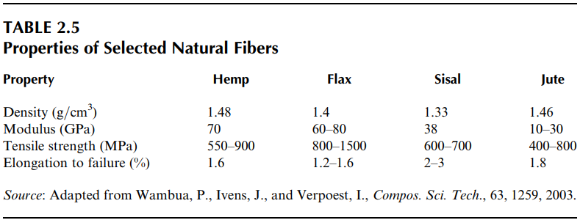
Theory of machines Wessam Al Azzawi
Lecture 2: Types of fibres
Natural fibers
The properties of some of the natural fibers in use are given in Table

Slide 19
Theory of machines Wessam Al Azzawi
Lecture 2: Types of fibres
Natural fibers
Recently, natural fiber-reinforced polymers have created interest in the
automotive industry for the following reasons:
They are environment-friendly, meaning that they are biodegradable, and unlike glass and carbon fibers, the energy consumption to produce them is very small.
The density of natural fibers is in the range of 1.25-1.5 g/cm3 compared with 2.54 g/cm3 for E-glass fibers and 1.8–2.1 g/cm3 for carbon fibers.
The modulus–weight ratio of some natural fibers is greater than that of E-glass fibers, which means that they can be very competitive with E-glass fibers in stiffness-critical designs.
Natural fiber composites provide higher acoustic damping than glass or carbon fiber composites, and therefore are more suitable for noise attenuation, an increasingly important requirement in interior automotive applications.
Natural fibers are much less expensive than glass and carbon fibers.

Slide 20
Theory of machines Wessam Al Azzawi
Lecture 2: Types of fibres
Natural fibers
limitations of natural fibers.
The tensile strength of natural fibers is relatively low.
low melting temperature
At temperatures higher than 200ºC, start to degrade, The degradation starts at the hemicellulose and then the lignin. The degradation leads to odor, discoloration, and deterioration of mechanical properties.

Slide 21
Theory of machines Wessam Al Azzawi
Lecture 2: Types of fibres
Boron fibers
The most prominent features of boron fibers are:
Extremely high tensile modulus, which is in the range of 379–414 GPa.
Relatively large diameter.
Excellent resistance to buckling, which in turn contributes to high compressive strength for boron fiber-reinforced composites.
The principal disadvantage of boron fibers is their high cost, which is even higher than that of many forms of carbon fibers.
It is restricted to a few aerospace applications.

Slide 22
Theory of machines Wessam Al Azzawi
Lecture 2: Types of fibres
Boron fibers
Boron fibers are manufactured by chemical vapor deposition (CVD) of boron onto a heated substrate (either a tungsten wire or a carbon monofilament). Boron vapor is produced by the reaction of boron chloride with hydrogen:
2BCl₃ + 3H₂ = 2B + 6HCl

Slide 23
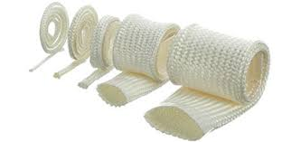
Theory of machines Wessam Al Azzawi
Lecture 2: Types of fibres
Ceramic fibers
Silicon carbide (SiC) and aluminum oxide (Al2O3) fibers are examples of ceramic fibers notable for their high-temperature applications in metal and ceramic matrix composites.
Their melting points are 28308C and 20458C, respectively.
Silicon carbide retains its strength well above 6508C, and aluminum oxide has excellent strength retention up to about 13708C.
Both fibers are suitable for reinforcing metal matrices in which carbon and boron fibers exhibit adverse reactivity.
Aluminum oxide fibers have lower thermal and electrical conductivities and have higher coefficient of thermal expansion than silicon carbide fibers.

Slide 24
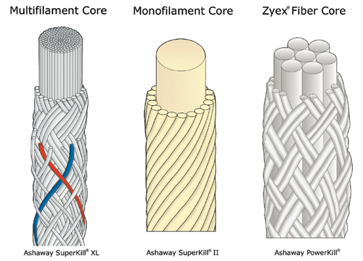
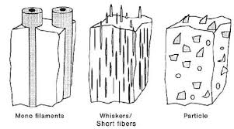
Theory of machines Wessam Al Azzawi
Lecture 2: Types of fibres
Ceramic fibers
Silicon carbide fibers are available in three different forms:
Monofilaments
Multifilament yarn
Whiskers

